Slide 1







AI PROJECT
Presented by :
Purvi Chopra
Harman Singh Deol
Akashdeep Singh
Vanshika Sharma
Btech CSE (AI & DS) - B
SEM - II

Slide 2










Linear Regression
House Price Prediction ML model
Polynomial Regression
Machine Learning Model on Housing Dataset
Random Forest
R2 Score

Slide 3



Objective
This objective focuses on creating a machine learning model that can predict house prices based on input features.
Visualize relationship
Visually evaluate model accuracy and behavior.How data points are distributed. How well the model fits the data
Build regression model
focuses on creating a machine learning model that can predict house prices based on input features.
Improve accuracy
Reduce prediction error and increase model performance (measured using R² score).

Slide 4
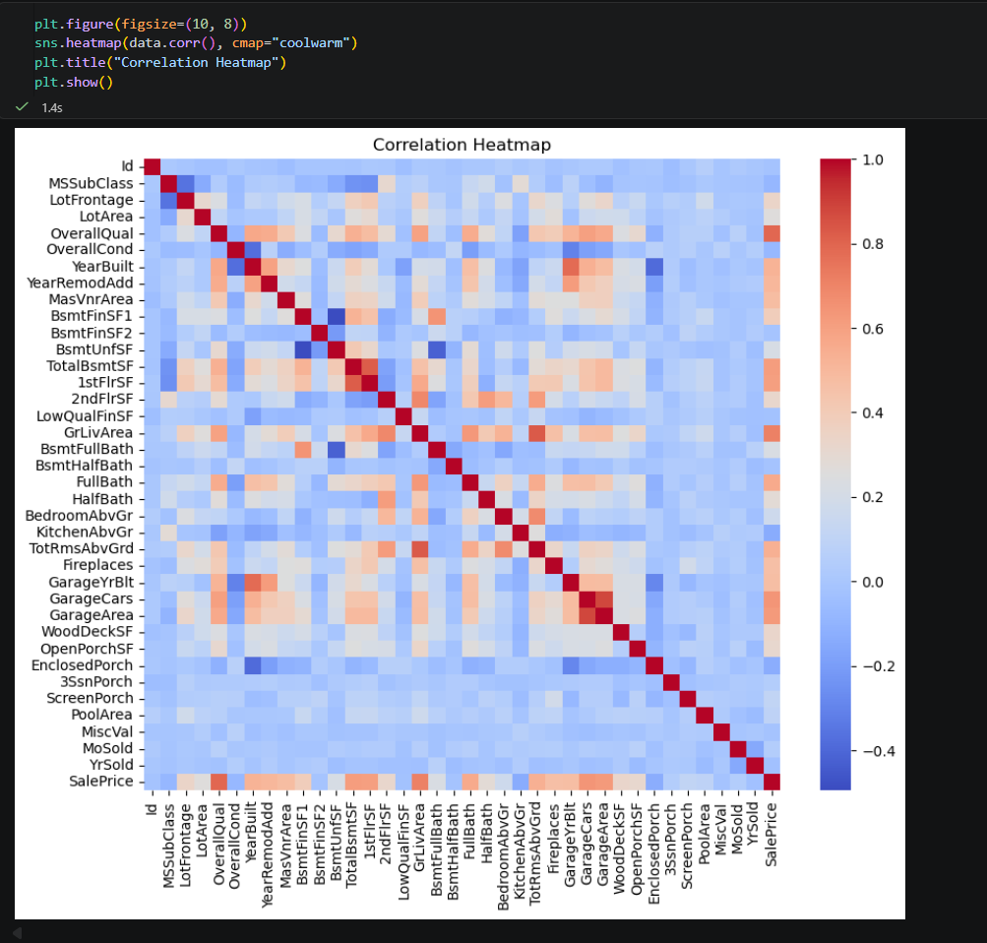
Problem- crowded heatmap

Slide 5
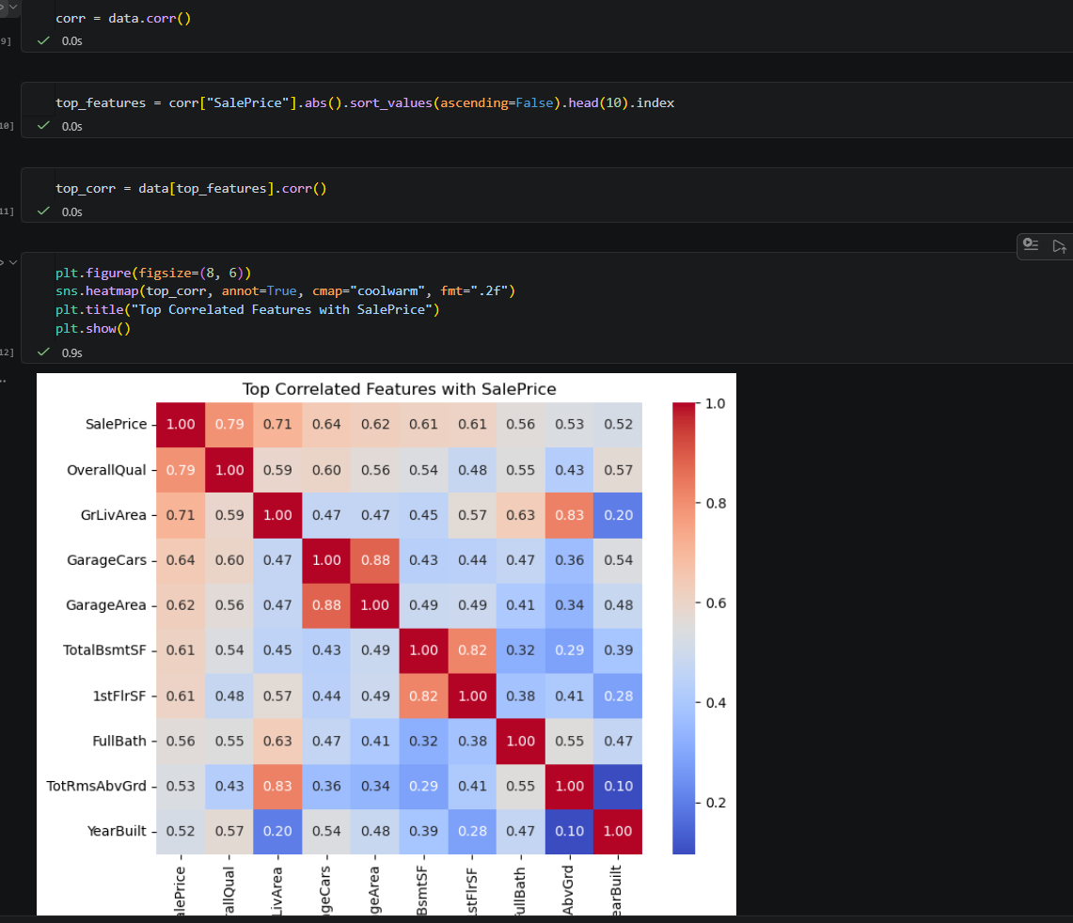
Solution :
Analyze only important data values using corr()

Slide 6
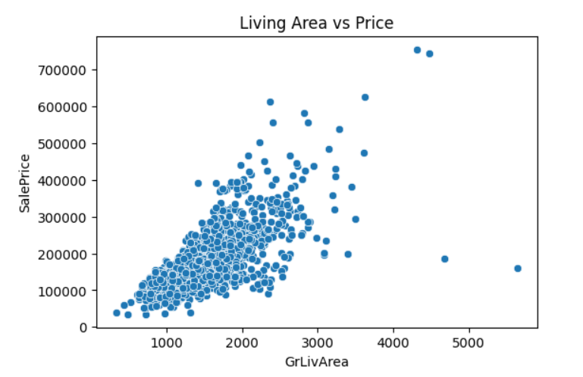
Scatter Plot
The scatter plot shows a clear positive relationship between living area (GrLivArea) and sale price—larger homes generally sell for more. However, the spread increases as size grows, indicating more variability in prices for bigger houses. There are also a few outliers, such as very large homes with relatively low prices and some high-priced properties that stand apart from the main cluster.

Slide 7
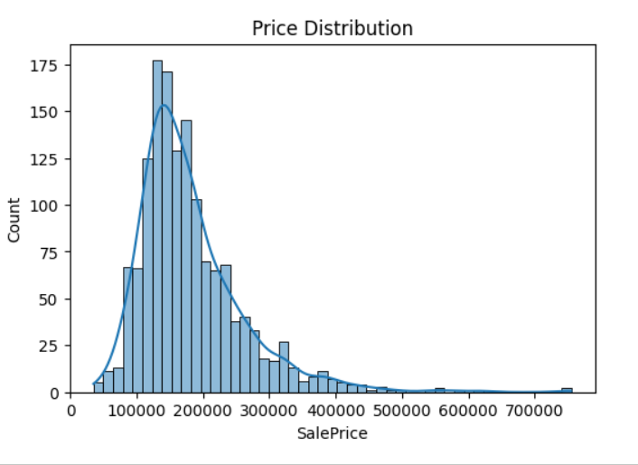
Histplot
The data is right-skewed (positively skewed)
Most houses are in the lower to mid price range, with fewer expensive houses
Major concentration:
Prices are mostly between ₹100,000 – ₹250,000 (approx.)
Peak (mode):
Around ₹150,000 – ₹180,000 → most common price range
Long tail:
A small number of houses have very high prices (up to ~₹700,000+)
These are outliers

Slide 8


Linear v/s Polynomial
Linear Regression
Polynomial Regression
Assumes a straight-line relationship between input and output
Change in output is constant with respect to input
Simple and easy to interpret
Extends linear regression by adding higher-degree terms
Can model curved relationships
More flexible than linear regression
Captures non-linear trends
vs

Slide 9
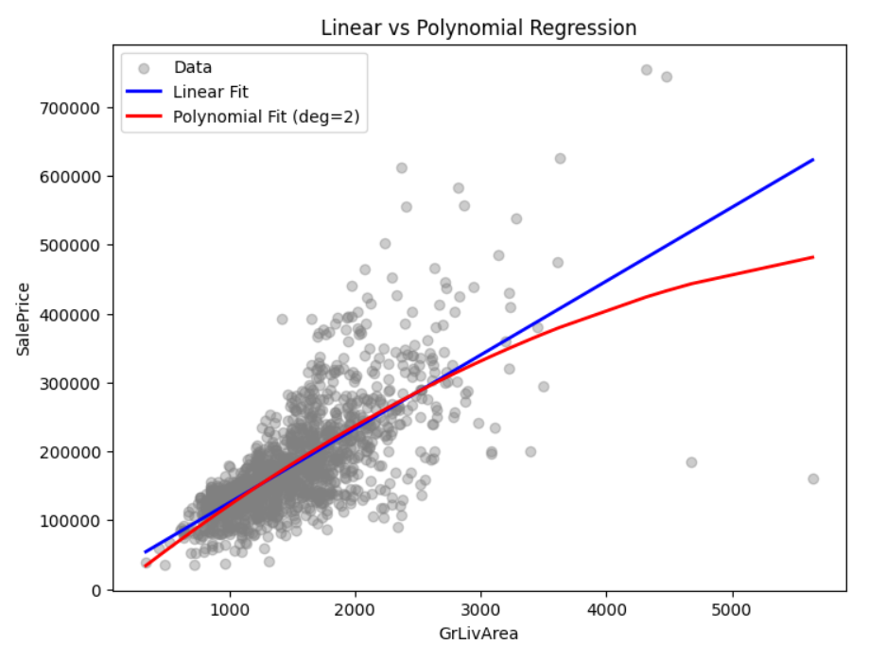

Slide 10
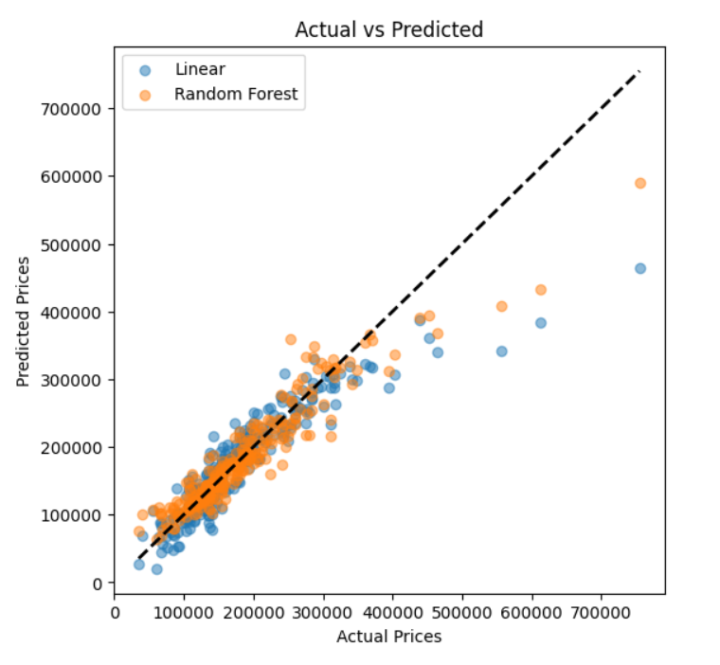
Actual v/s Predicted
Both models (Linear and Random Forest) show a strong positive alignment with actual prices, indicating decent predictive performance.
Points closer to the diagonal dashed line represent more accurate predictions.
The Random Forest model (orange) generally clusters closer to the diagonal, suggesting slightly better accuracy overall.
The Linear model (blue) shows more dispersion, especially at higher price ranges.
Both models tend to underpredict very high-priced homes (points fall below the diagonal at the upper end).
Prediction errors increase as actual prices rise, indicating reduced accuracy for expensive properties.

Slide 11









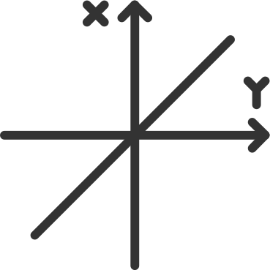
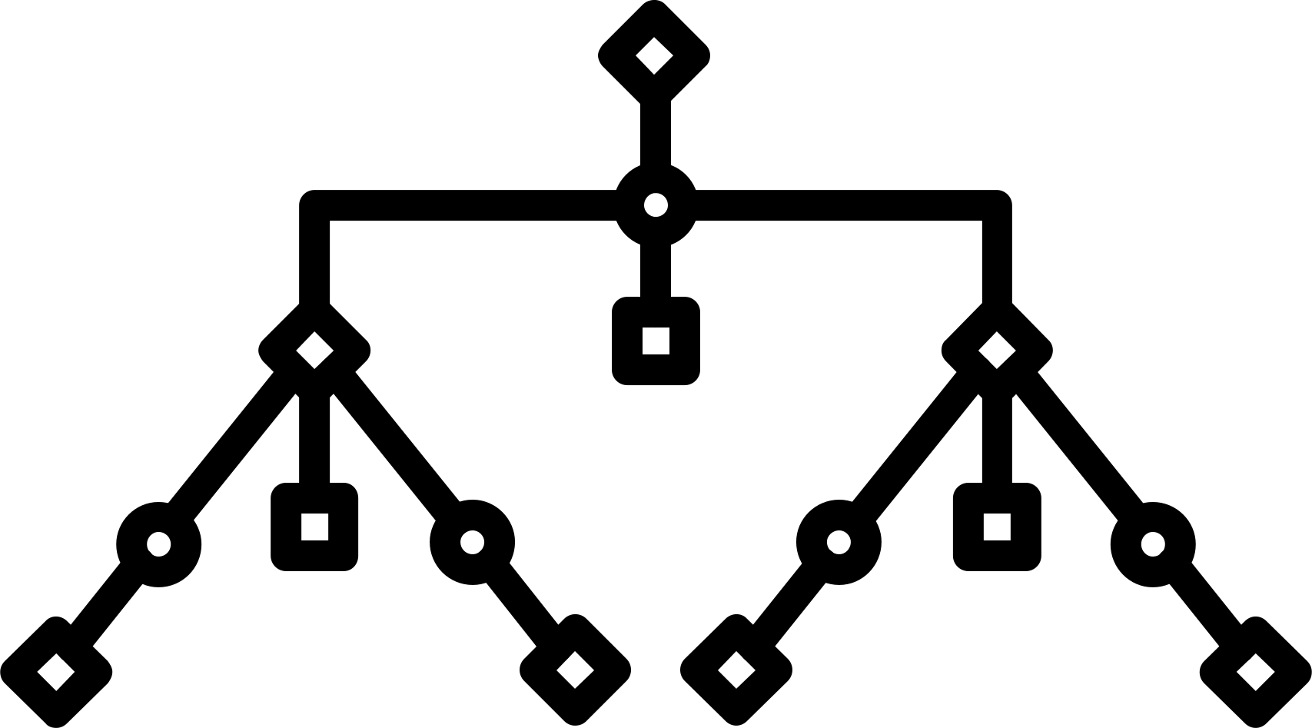

R2 Score
Linear Regression
Random
Forest
Polynomial Regression
R² score (coefficient of determination) measures how well a regression model explains the variability of the target variable.
01
02
03
Linear Regression performs well with an R² of ~0.823, capturing a large portion of the variance but less than Random Forest.
Random Forest has the highest R² (~0.888), indicating the best fit and strongest predictive performance among the models.
Polynomial Regression has a much lower R² (~0.533), suggesting poor fit and weaker predictive ability.

Slide 12

Outcome of Model
✅ Accurate price prediction (to a good extent):
Using Polynomial Regression, your model captures the curved relationship between GrLivArea and SalePrice, giving better predictions than a simple linear model.
📈 Better understanding of data behavior:
You discovered that house prices don’t increase linearly—they grow faster after a certain size.
📊 Improved model performance:
Compared to linear regression, your model likely shows a higher R² score and better fit on the graph.

Slide 13


Summary
Linear Regression: Best for simple, straight-line relationships between variables. It’s easy to interpret and works well when the trend is roughly linear, but struggles with complex patterns.
Polynomial Regression: Extends linear models to capture curved relationships. Useful when data shows non-linear trends, but can easily overfit if the degree is too high or not tuned properly.
Random Forest: A powerful ensemble method that handles complex, non-linear relationships automatically. It is more accurate and robust than simple models but less interpretable.
Other models/graphs (e.g., scatter plots, residual plots): Used to visualize relationships, detect patterns, and evaluate model performance. They help in choosing the right model and diagnosing issues like outliers or under/overfitting.

Slide 14




